Slide 1




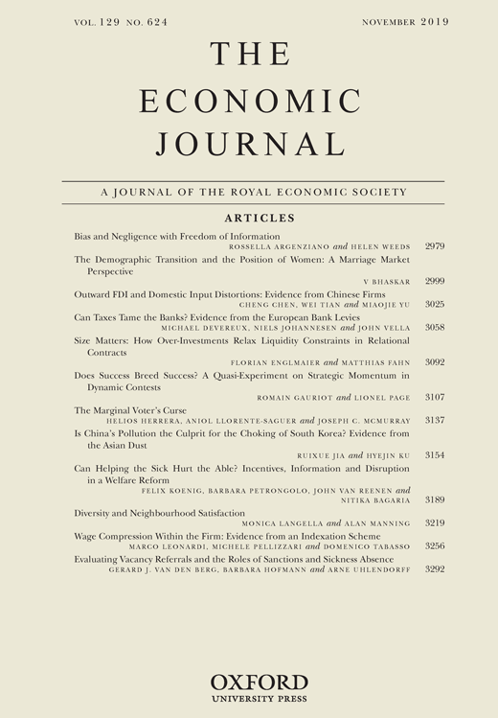

Getting your Work Published
Nezih Guner (CEMFI) and Imran Rasul (UCL, IFS)

Slide 2

Where to send?
Aim high (to top-5 or not to top-5……)
But be realistic
  what is the contribution of your paper?
  who is going to want to read your paper?
  what papers do you reference?
Look at the Journal you plan to submit to
  what sort of papers does the journal publish?
  what are the Editors’ interests?
  who are the Associate Editors?

Slide 3

What criteria will the Editor use?
Novelty of your contribution
  is the method new? is it an existing method applied in a new context or to new data?
Importance of research question
  who will want to read it? how does that compare to the readership of the journal?
Clear presentation, well organized
  make sure the message is clear; is it easy to read
  if readers don’t get what you are doing or your message don’t blame them, it is almost certainly your fault for not explaining it clearly, your work should be transparent

Slide 4

Before you sent your paper, make sure the paper is polished!
Writing a academic paper is not like writing a thriller.
• There should be absolutely no surprises or cliffhangers.
• The contribution of the paper should be the first thing you say and (if possible) the first result you state.
• The punch line of each section should be stated in the first paragraph of that section.
• What is written should be readily understandable by any of your fellow colleagues.
• Lay the paper out in the standard format.
• The notation and terminology should be consistent with standard practice, “agent”, “individual”, “player”,…

Slide 5

Before you sent your paper, make sure the paper is polished!
All aspects of your paper matter.
• Abstract – concise but informative and accurate.
• Introduction – indicative of your contribution and its place in the literature.
• Body – carefully describe your model, the variables, the timing, the data and results, your robustness checks and any policy implications.
• Conclusion: Don’t underestimate its importance.
• References: Complete and consistent with text.
• Spell check and proof read.
“If it doesn’t look easy you haven’t worked hard enough.”

Slide 6

Introduction, Introduction, and Introduction
The Introduction is the most important part, it is all some people will read
You should clearly state your contribution, ideally on the first page "Our contribution in this paper is....“
The Introduction should be clear and to the point you do not need to include a long and comprehensive list of all papers in the literature, or provide a long motivation.
Give a short paraggraph or two of motivation then state your contribution
You should write, rewrite, rewrite, rewrite, rewrite, rewrite... the
Introduction

Slide 7

Do not strategize too much
Should I cite this or that paper? Remember “Google” knows everything!
Should I suggest referees or not, NO
Should I suggest that some people should not be a referee, NO
Should I mention previous rejections, MAY BE

Slide 8

What to do with rejections?
Read through the reports, put them down and walk away for a day or two before you do anything
Go through the comments as with a revise and resubmit. Remember the paper might go to the same referees in another journal.
Some journals allow you to submit past reports and how you have revised the paper. There are arguments for and against
Don’t get disheartened. Everyone gets rejected.
Have thick skin. The referees are criticizing your paper, not you

